Slide 1
Technical Analysis of Established Blockchain Systems
Florian Haffke, 20.11.2017, Munich

Slide 2
Outline
Research Questions
Blockchain Basics
Wrap-up Bitcoin, Ethereum and Ripple
Analysis Extract – High-level and Design Space

Slide 3
Research Questions
1. Which are established Blockchain Systems?
2. What is the respective Setup of established Blockchain Systems?
3. How do established Blockchain Systems differ?
4. What are crucial Components and Characteristics of all established Blockchain Systems?
5. How can a Design Space of Blockchain Systems be defined?
Notes:
Kick Off -> 6 quantitative + 2 qualitative Criteria -> Bitcoin, Ethereum and Ripple
Wrap-up 2+3

Slide 4
Research Questions
2. What is the respective Setup of established Blockchain Systems?
3. How do established Blockchain Systems differ?
4. What are crucial Components and Characteristics of all established Blockchain Systems?
5. How can a Design Space of Blockchain Systems be defined?
1. Which are established Blockchain Systems?
Notes:
Kick Off -> 6 quantitative + 2 qualitative Criteria -> Bitcoin, Ethereum and Ripple
Wrap-up 2+3

Slide 5
Outline
Research Questions
Blockchain Basics
Wrap-up Bitcoin, Ethereum and Ripple
Analysis Extract – High-level and Design Space

Slide 6
Chaining of Blocks
Block 3 Header
Block 4 Header
Block 5 Header
…
…
…
PrevBlock Hash: 0x200d3…
PrevBlock Hash: 0x033fe…
PrevBlock Hash: 0x404fe…
…
…
…
…
…
…
…
…
…
Root Hash: 0x3ed4…
Root Hash: 0x45ed…
Root Hash: 0x5f3d…
..
..
..
..
..
..
Block 3 Body
Block 4 Body
Block 5 Body
Tx
Tx
Tx
Tx
Tx
Tx
Tx
Tx
Tx
Tx
Tx
Tx
Tx
Tx
Tx
Tx
Tx
Tx
Notes:
Public -> Tx-based
Meta Data Structure, e.g. Merkle Hash Tree -> Connections of Body Data
Connection of previous and subsequent Block via Hash pointers -> Chain
Hash functions varying

Slide 7

Transactions Graph
Coinbase Tx
Coinbase Tx
Coinbase Tx
Tx
Tx
Tx
Tx
Tx
Tx
Block
0
1
2
3
4
5
6
7
Time
Notes:
Ownership Graph
Transactions vs. Addresses
Validation of Data at Logical Global Time (Blocks)

Slide 8
Outline
Research Questions
Blockchain Basics
Wrap-up Bitcoin, Ethereum and Ripple
Analysis Extract – High-level and Design Space

Slide 9


Goals
Bitcoin
      Trustless and anonymous peer-to-peer electronic cash system
Ethereum
      General-purpose platform for building transaction-based state machines
Ripple
      One global connected payment network for cheaper and faster settlements
Blockchains
  Tamper-resistant blocks with non-reversible transactions
Notes:
Secure by Design, i.e. Create+Read only (no Updates or Deletes)
Avoid Double spending
Distributed and Deterministic State Machine

Slide 10
1. Setup: State Data
      Set of Unspent-Transactions-Outputs (UTXOs)
      Mapping of account objects comprising balance and key-value storage to addresses
      Concatenation of single account ledgers comprising balance and address
Notes:
State Replication and Calculation at every Node
UTXOs are scripts embedded in transactions
ETH, XRP full state in every block
Token: Chain of valid signatures vs. Parameter Value

Slide 11
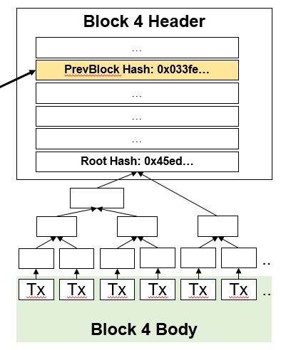
2. Setup: Consensus and Transitions
      Proof of Work mining race
      Stack-based script execution binding transactions
      Proof of Work mining race
      Smart contract execution in Ethereum Virtual Machine
      Proof of Correctness without mining rewards
      Trivially updating account ledger value
State transitions are triggered by transactions and finalized in a new block under distributed consensus.
Every valid block alters the state deterministically.
Notes:
Consensus:
PoW: Costly to calculate, easy to verify
Condition longest chain incentive -> No double spending, eventual/weak consistency
Round-based
Transitions:
BTC: Redeem UTXOs via execution of scripts embedded in transactions
ETH: Unique scripting language + Smart Contracts Turing-complete (loops until Gas) -> automatization of accounts
XRP: JSON, no smart contracts -> security, simplicity, scalability
Deterministic: Validity checks and calculation at every node under uniform rules

Slide 12
3. Setup: Peer-to-Peer Network
Full Node/Validator
Client Node
UNL Connection
Semi-random Connection
Distributed
Decentralized
Notes:
Unstructured + Equipotent -> More Anonymous
Permissioned + Layered -> More Scalable
CAP Theorem

Slide 13
Outline
Research Questions
Blockchain Basics
Wrap-up Bitcoin, Ethereum and Ripple
Analysis Extract – High-level and Design Space

Slide 14

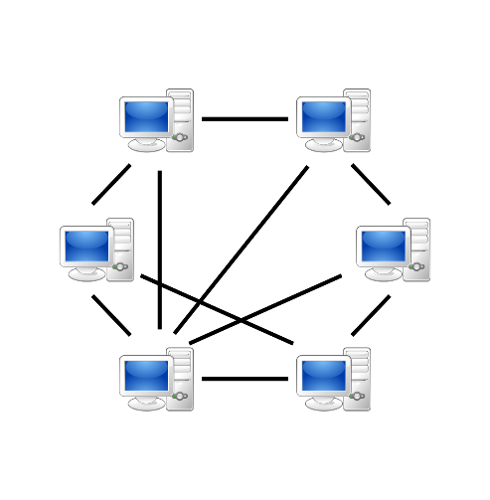
A Generic View of Blockchain Systems
State Transition System
Consensus
Calculate
State0
State1
Developer
Comprise
Maintainer
Blockchain
Store
Genesis
Block
Hash Pointer
Block1
Protocol Rules
-Codebase-
Block
Hashing
Consensus
Tx System
Signing
Network
…
n:m
n:m
Transaction System
User
Create
Token
1:1
Transaction
n:m
n:m
n:m
Address
Network
Sign
Digital Signature Scheme
Draw
Notes:
Crucial:
Hash Trees -> Efficiency (lower Latency and Higher Tx Throughput)
Protocol Updates (Dynamic Adaption against Attacks or Hash Breakthroughs)
P2P Entrance Point for new Nodes
DSA Pseudo-anonymous
Specific Features:
Smart Contracts: Implement + Compile off Chain, Deploy in Bytecode via Transaction on Chain, Execution in State Transition System
Token: Native or Issuances (USD)

Slide 15
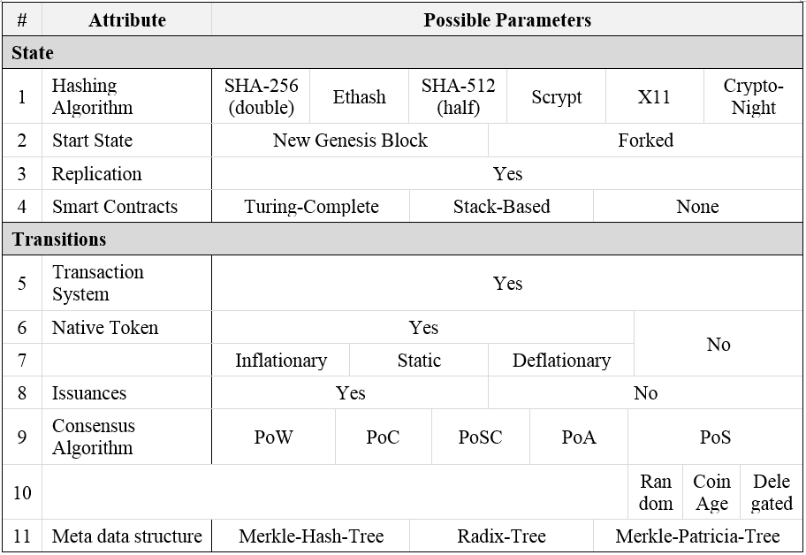
Morphology Part 1
Notes:
Yes -> Including Crucial Components
External vs. internal resource for Consensus

Slide 16
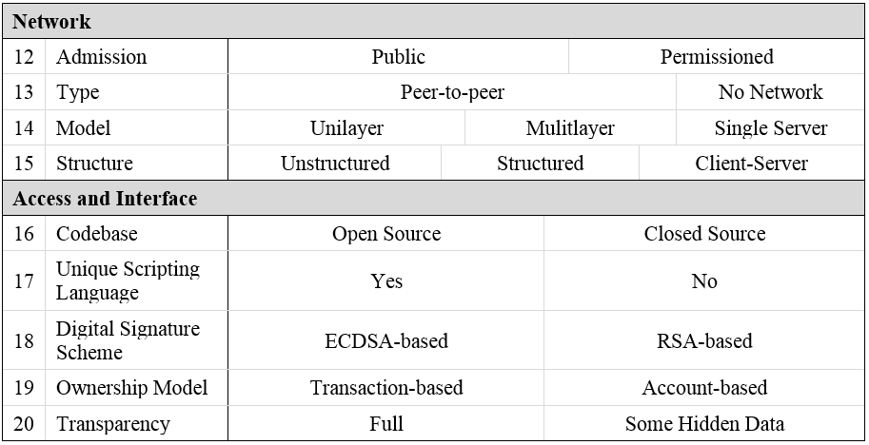
Morphology Part 2

Slide 17
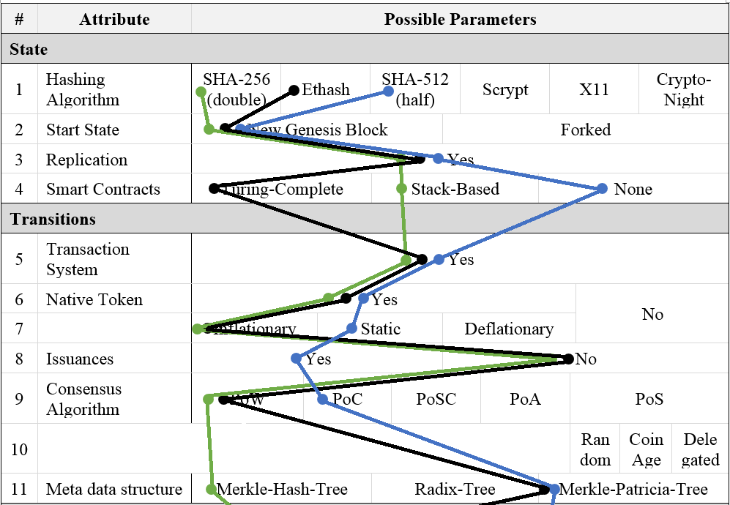


Classification Part 1

Slide 18
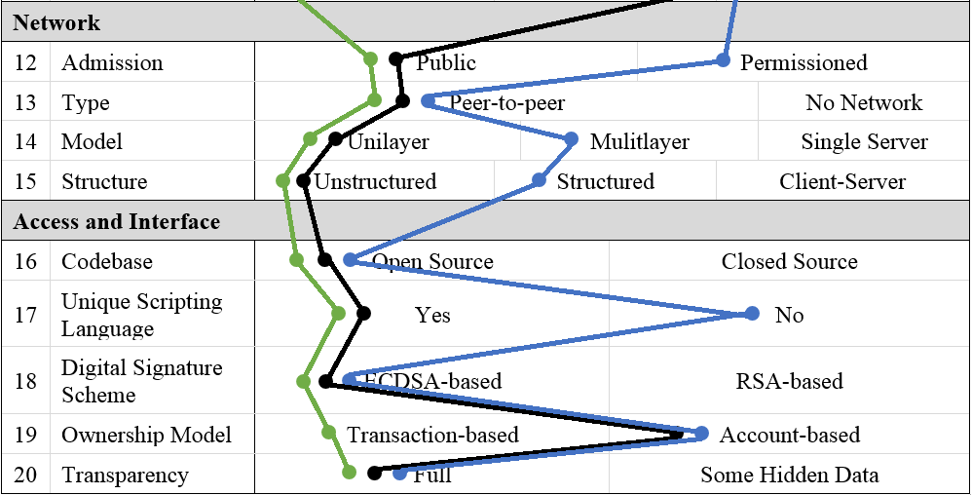
Classification Part 2

Slide 19
Questions and Feedback
Thank you for your Attention ☺

Slide 20
B.Sc. Information Systems
Florian Haffke
florian.haffke@tum.de

Slide 21
Appendix

Slide 22
Research Strategy
High-level Studies and Design Space
Comparative System Studies
Ancillary Literature
Individual Study
Bitcoin
Individual Study
Ethereum
Individual Study
Ripple
Identify Systems
------------------------------------------
Basic Terms + Candidate Criteria
Data
Analysis
Synthesis

Slide 23
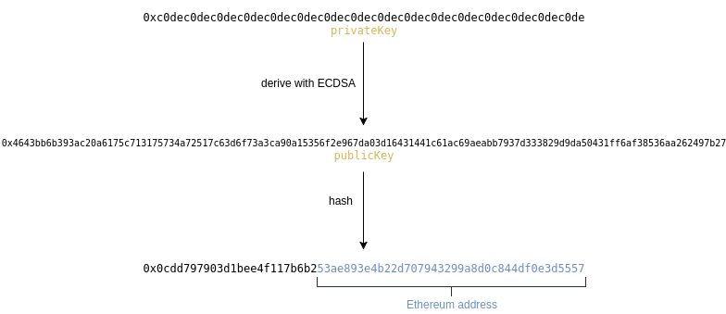
Digital Signature Scheme and Addresses
ECDSA
tx data
tx data
private key
signature
public key
hash
address
create
verify
Example Ethereum

Slide 24
Bitcoin Script Execution
Transaction 1
4043660…
b90d211...
scriptSig
335e627…
2010ddc...
scriptSig
Transaction 2
OP_DUP
OP_HASH160
3331fdb…
OP_EQUALVERIFY OP_CHECKSIG
Execution
5145ded…
2dd22e2…
scriptPubKey
OP_DUP
OP_HASH160
4442ef3…
OP_EQUALVERIFY OP_CHECKSIG

Slide 25
Ethereum Virtual Machine
EVM Execution Cycle
World State
Account0
Account1
Account2
…
Machine State
Gas available
LIFO stack
Word-array memory
…
Environmental Tuple
Sender
Transaction Value
Block Header
Machine Code
Gas Price
…
Next Transaction
Instructions
0x01 ADD
0x60 PUSH1
0x00 STOP
…
Iteration Function
Get Instruction
Update States
Reduce available Gas
…
No
Yes
Halt?
Notes:
Bytecode RLP

Slide 26
Ripple Issuance Transfers with Interledger
Sender
Receiver
Alice
Bob
Application
Transport
Connector 1
Connector n
Bank A
Bank B
Interledger
ILP
ILP
ILP
ILP
Ledger
XRP Plugin
XRP Plugin
USD Plugin
USD Plugin
XRP Plugin
XRP Plugin
Ripple Ledger
USD-Ledger
Ripple Ledger

